Slide 1
CS 4530: Fundamentals of Software Engineering Lesson 9.3 Static Program Analysis
Jonathan Bell, Adeel Bhutta, Ferdinand Vesely, Mitch Wand
Khoury College of Computer Sciences
© 2022 Released under the CC BY-SA license

Slide 2
Learning Objectives for this Lesson
By the end of this lesson, you should be able to:
Explain good uses for static analyzers
List limitations of static analyzers and program verification

Slide 3
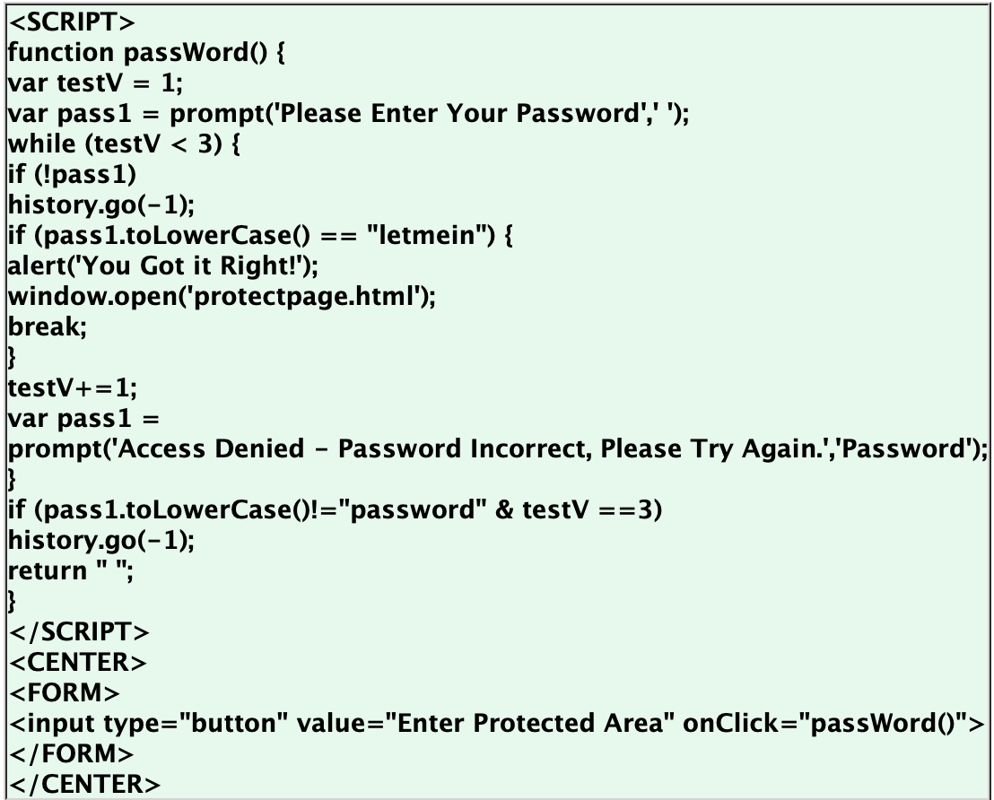
Why Static Analysis?
CWE-798: Use of Hard-coded Credentials

Slide 4
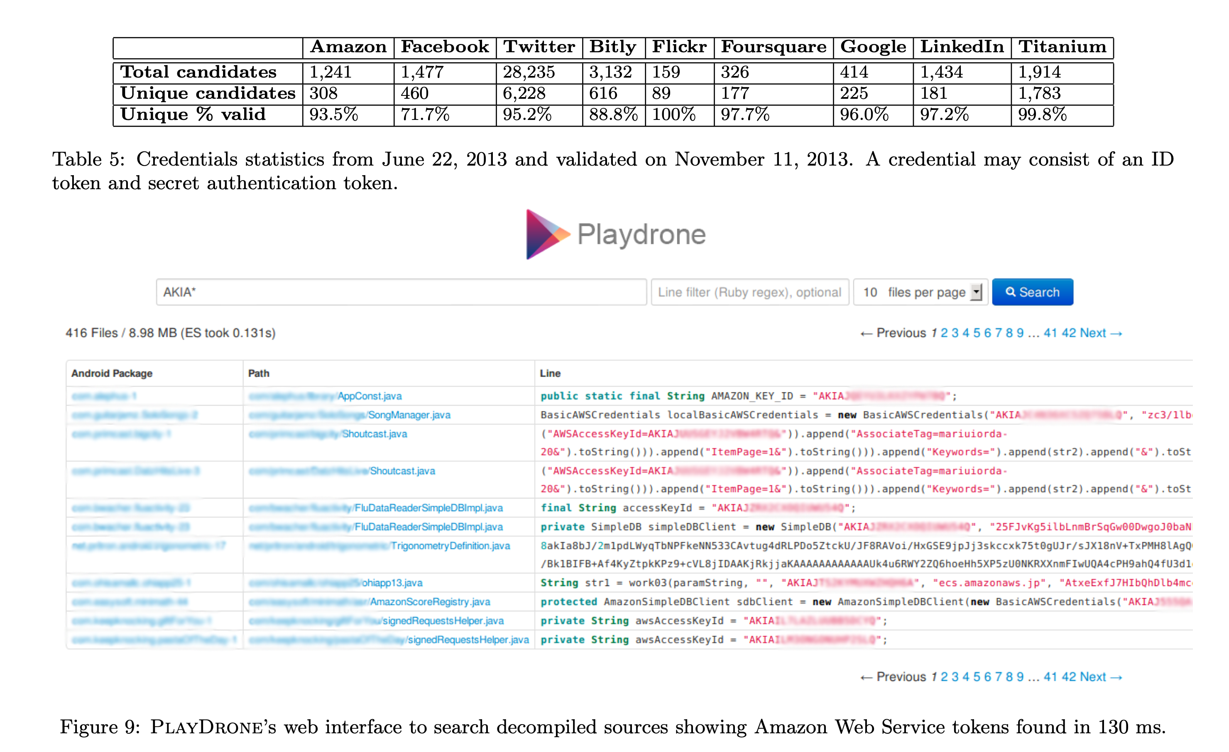
Why Static Analysis?
CWE-798: Use of Hard-coded Credentials: Study of 1.1m Android Apps
“A Measurement Study of Google Play,” Viennot et al, SIGMETRICS ‘14

Slide 5
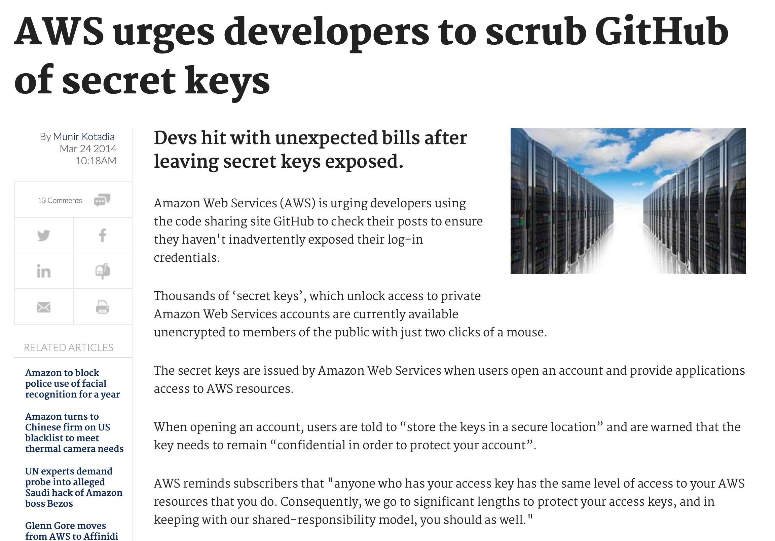
Why Static Analysis?

Slide 6

Why Static Analysis?
GitGuardian (Launched in 2017)
Notes:
How does it work? Just looks for regex, this is not actually that hard

Slide 7
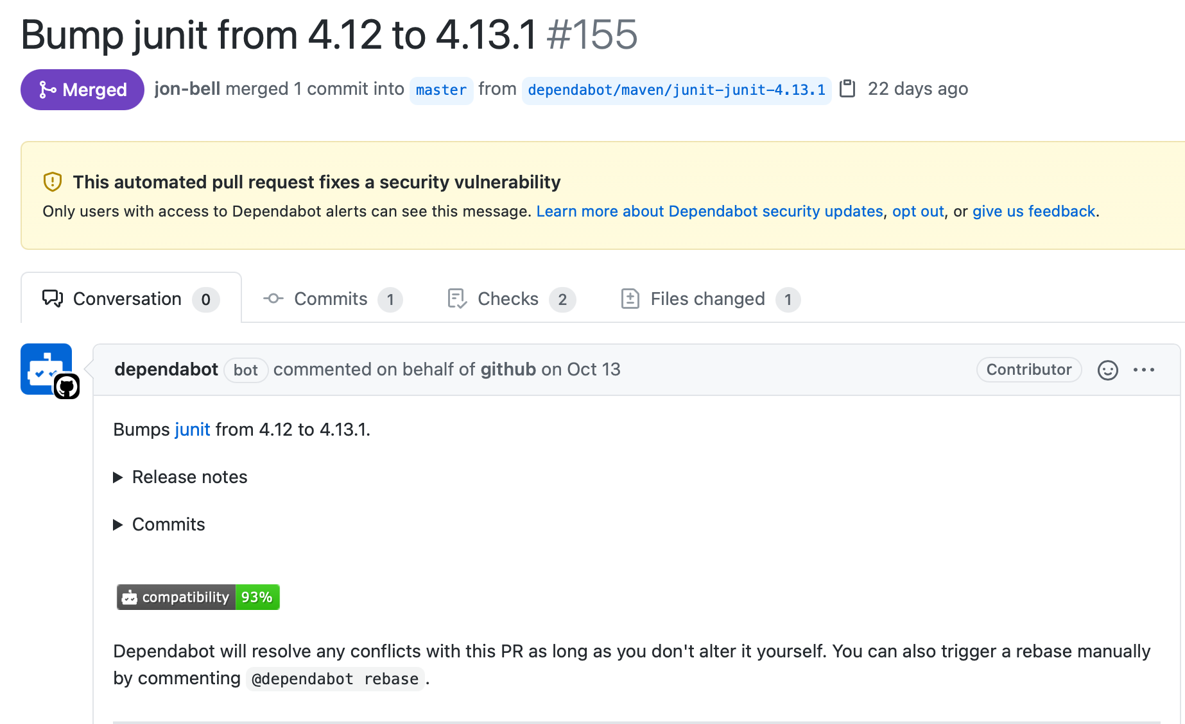
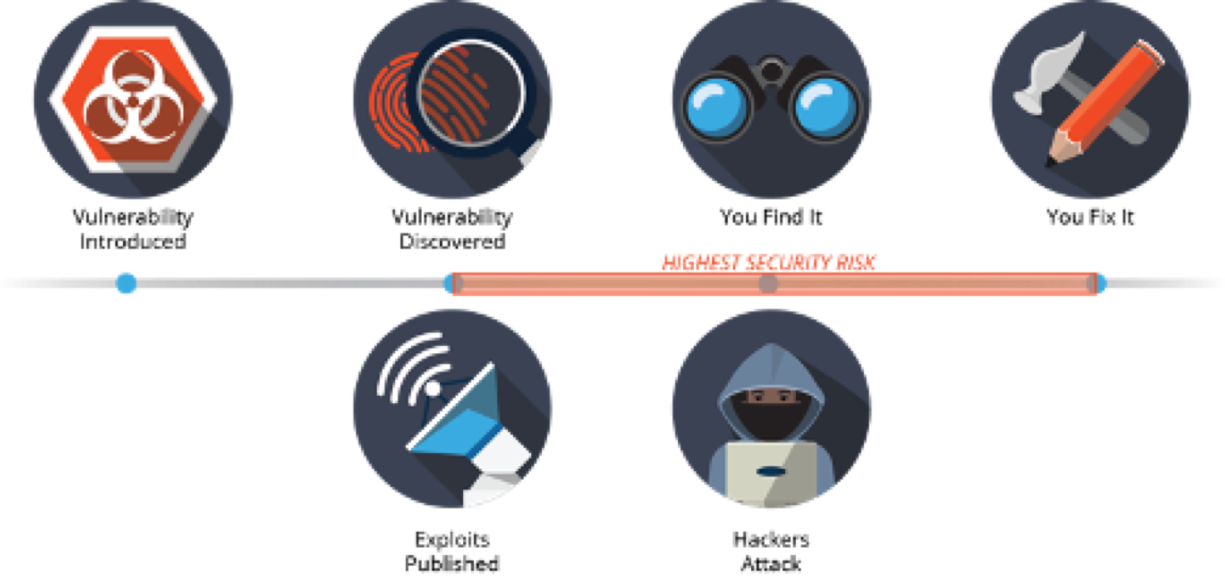
Why Static Analysis?
A9:2017-Using Components with Known Vulnerabilities
Notes:
This one is also not that hard: just need to look at dependencies

Slide 8
Bug Detection
Report
False Positive
True Positive
True Negative
False Negative
We generate a
false alarm.
We correctly
detect a bug.
Bug is absent
Bug is present
We correctly
find no problem.
We miss a bug
in the system.
No Report

Slide 9
Static Program Analysis
Bug finders and partial verification use static program analysis
Reads in the program (just like a compiler);
Analyze to determine properties:
E.g., are all open resources eventually closed?
”static” means ”without running the program”.
All non-trivial properties are undecidable
Approximations are always necessary: make a choice
E.g., miss some closes of open resources, or
Miss some open resources not being closed.

Slide 10
Compromises with Static Analysis
Getting precise results may take time:
Many algorithms are exponential in precision measures.
Getting precise results may require whole program:
If parts of the program loaded at runtime:
Analysis results may be very imprecise, or (worse)
Incorrect, if they assume the whole program is available.
Getting precise results may require intervention:
Code may need to be annotated with information:
E.g., this method may return an open resource.

Slide 11
Effects of Analysis Imprecision
FALSE NEGATIVES
FALSE POSITIVES
The static analysis misses something ”bad” in program:
Bug not found.
Can give a false sense of security.
Can be reduced, but at the cost of false positives!
The static analysis reports a problem that doesn’t exist:
There is no bug.
Real bugs can be swamped by a flood of spurious reports.
Programmer time is wasted chasing down false leads.

Slide 12
Google defined “Effective False Positive”
A report from static analysis is effectively false,
If it is ignored by developers;
Whether or not it represents a true bug.
Even if the report is technically correct
It may refer to something considered unimportant:
E.g., who cares if all the files aren’t closed, if the program is about to exit anyway.
E.g., yes, there is a race condition between two logging statements, but that’s not important.
Even if the report is technically wrong
Developers may see potential problem, and fix.

Slide 13
Criteria For Automated Program Analysis
Efficient and Easy
Should not require whole program or annotations.
Rarely spurious
No more than 10% effectively false positive.
Actionable
Should point out things easy to fix.
Effective
Problems should be perceived as important.
Automatically applied
during Code Review.
Source: Software Engineering at Google, Chapter 20

Slide 14
Defects Static Analysis can Catch
Defects that result from inconsistently following simple, mechanical design rules.
Security: Buffer overruns, improperly validated input.
Memory safety: Null dereference, uninitialized data.
Resource leaks: Memory, OS resources.
API Protocols: Device drivers; real time libraries; GUI frameworks.
Exceptions: Arithmetic/library/user-defined
Encapsulation: Accessing internal data, calling private functions.
Data races: Two threads access the same data without synchronization
Key: check compliance to simple, mechanical design rules
Notes:
Catch interesting errors that testing won’t, safety-critical systems.

Slide 15
Program Verification as an Alternative to Testing
So “program testing can be used to show the presence of bugs, but never to show their absence” (Dijkstra’s Law), what can we do?
Testing is limited to finite concrete cases;
Can we check unbounded symbolic cases?
Yes … with caveats
Notes:
We talked about testing, and about “Dijkstra’s Law” about how testing can show presence of bugs – in the concrete cases that we are testing.
But: can we show that bugs are absent? That our code is correct by considering all possible cases? Yes, we can via program verification, but with some caveats.
Caveats:
We can only show that a program is correct with relative to a specification. What if the specification is incomplete?
Often quite tedious and slow – usually deemed not feasible on consumer software projects
Often requires expertise in formal methods

Slide 16

Verification Checks Code Against Specification
A Specification: What the system is supposed to do.
B Code: What the system actually does.
Difficulties:
Need a full formal specification;
Even proving termination is undecidable, let alone proving adherence to a specification.

Slide 17
A Full Formal Specification
… precisely defines exactly the behavior that the system should have:
What the outputs are in terms of the inputs;
What behaviors the system should have.
Wait a minute! That’s called a program.
Yes, a full formal specification is essentially a program, perhaps expressed at a higher level.
… with all the complexity that entails,
… including bugs!
Inefficiently
(w/o algorithms)
We can’t avoid
Human fallibility.

Slide 18
Verification Doesn’t Prove Presence of Bugs
Verification fails if
Missing lemma for unit behavior, or
Cannot verify loop invariant, or
Functional specification missing a piece, or
Run out of time trying to construct proof, or
Specification is wrong.
Constructing the proof can easily take as long as constructing the software, if not much more.
Just because there is no proof does not mean the software has a fault.

Slide 19
Full Verification is (Still) Hard
Full program verification is still relatively costly in terms of time and expertise
However, more and more lightweight formal methods are being used as part of development
Linters
Static type checkers

Slide 20
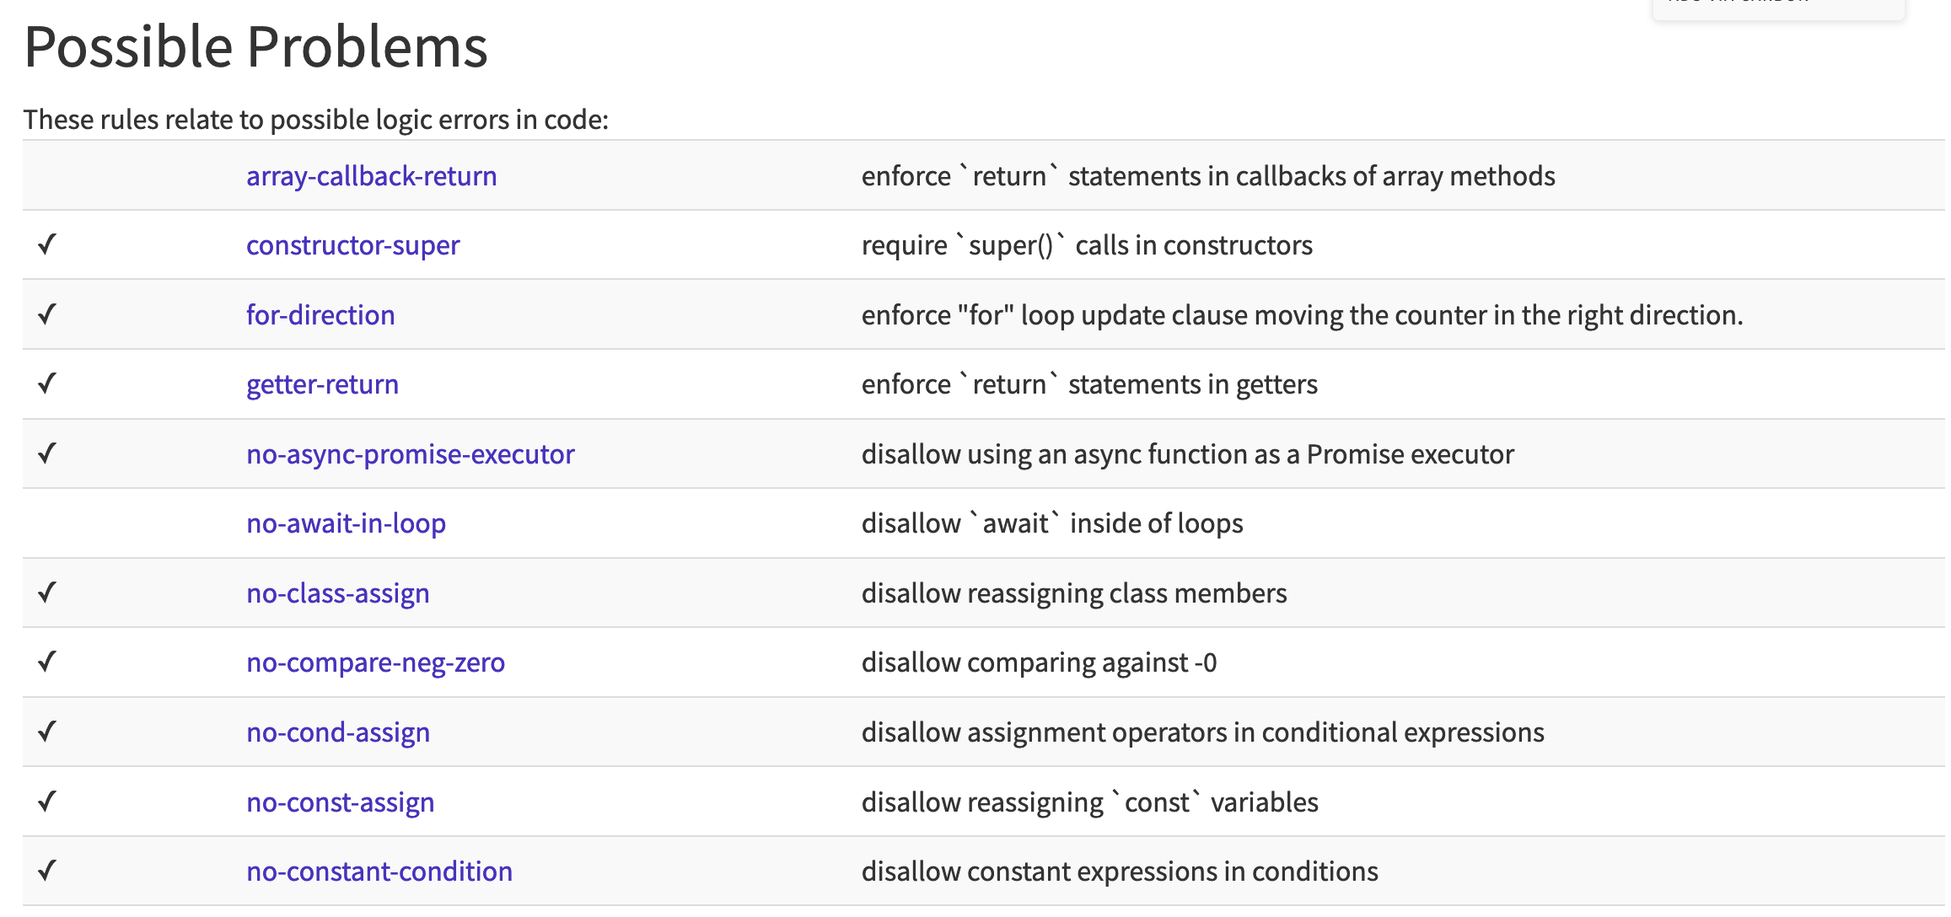
Example: ESLint
Linters = static analyzers for finding problematic patterns in code, stylistic errors, bugs
ESLint is a popular linter for JavaScript
Customizable via a set of rules – JS code implementing a check

Slide 21
Example: Type systems
(Static) Type systems and type checkers are also static program analyzers
JavaScript is a dynamically typed language – types are only known at runtime, as values are computed
If a piece of code is not executed during testing, we will not know if it contains an inconsistent use of variables
Even if the code is executed, the error might not be detected

Slide 22
Example: Type systems
TypeScript adds a type system and checker that can be run before a program is run
A static type checker reads a program before its run and, essentially, proves that the program is free of some classes of bugs
A type is a formal property of a piece of code
E.g., “given an argument x of type number and an argument s of type string, function foo will compute a number (or fail)”
All code is checked for type errors, no type errors at runtime are possible

Slide 23
Verification
Perfect
Bug Finders
Partial
Verification
Optional
Type
Systems
Testing
Linters

Slide 24
Review: Learning Objectives for this Lesson
By the end of this lesson, you should be able to:
Explain good uses for static analyzers
List limitations of static analyzers
Explain when to integrate static analysis into builds.

